Slide 1
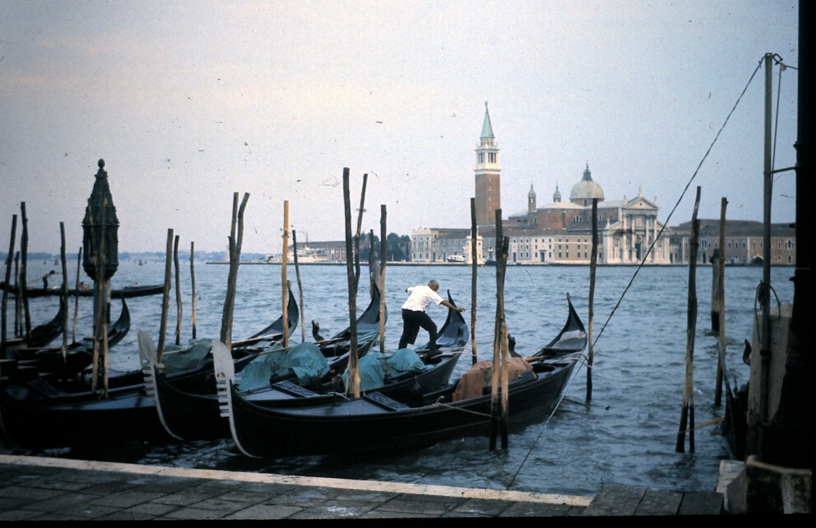
Development of master curricula for natural disasters risk management in Western Balkan countries
Middlesex University – Projects in the Western Balkans
Mike Dawney
Middlesex University
Interproject Coaching / March 6-8 2018
Project number: 573806-EPP-1-2016-1-RS-EPPKA2-CBHE-JP
"This project has been funded with support from the European Commission. This publication reflects the views only of the author, and the Commission cannot be held responsible for any use which may be made of the information contained therein"

Slide 2
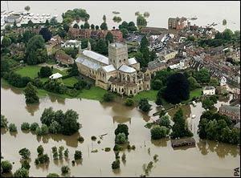
Development of master curricula for natural disasters risk management in Western Balkan countries
100 EU funded projects since 2003
20 in West Balkan Region
Main topics in the region:
HE reform
Refugees, Asylum, Human Trafficking, Border Management
Human Rights

Slide 3
Development of master curricula for natural disasters risk management in Western Balkan countries
2004
Towards an Integrated University via Internal Agreement
MU/University of Novi Sad

Slide 4
Development of master curricula for natural disasters risk management in Western Balkan countries
2006
Establishing Central University Services (CUS)
MU/University of the Arts, Belgrade

Slide 5
Development of master curricula for natural disasters risk management in Western Balkan countries
2007
Improvement and Restructuring of the Psychology Curriculum according to the Bologna Declaration (IRPC)
MU/Belgrade University

Slide 6
Development of master curricula for natural disasters risk management in Western Balkan countries
2009
Internal Quality Assurance at Serbian Universities (SIQAS)
University of Nis

Slide 7
Development of master curricula for natural disasters risk management in Western Balkan countries
2010
Strengthening the Student Role in Governance and Management at the Universities of Serbia in line with the Bologna Process (SIGMUS)
University of Belgrade

Slide 8
Development of master curricula for natural disasters risk management in Western Balkan countries
2010
Building Capacity for Structural Reform in Higher Education of Western Balkan Countries (STREW)
(Leading to Regional Platform for Benchmarking and Cooperation in Higher Education)
University of Novi Sad

Slide 9
Development of master curricula for natural disasters risk management in Western Balkan countries
2013
Fostering University Support Services and Procedures for Full Participation in the European Higher Education Area (FUSE)
University of Nis

Slide 10
Development of master curricula for natural disasters risk management in Western Balkan countries
2016
Development of master curricula for natural disasters risk management in Western Balkan countries
(NatRisk)
University of Nis

Slide 11
Development of master curricula for natural disasters risk management in Western Balkan countries
Some reflections ……
Start interproject coaching early (preferably before the project begins)
Don’t reinvent the wheel (learn from previous projects and build on them)
Be consistent within countries and preferably across the region
Resolve inconsistent interpretations of EHEA and other guidelines
Don’t follow project objectives blindly. Go where the project realistically takes you, and explain this to National Agency and EACEA
Work with other projects to resolve issues with governments/EACEA/Other agencies
Manage the change – with all stakeholders

Slide 12
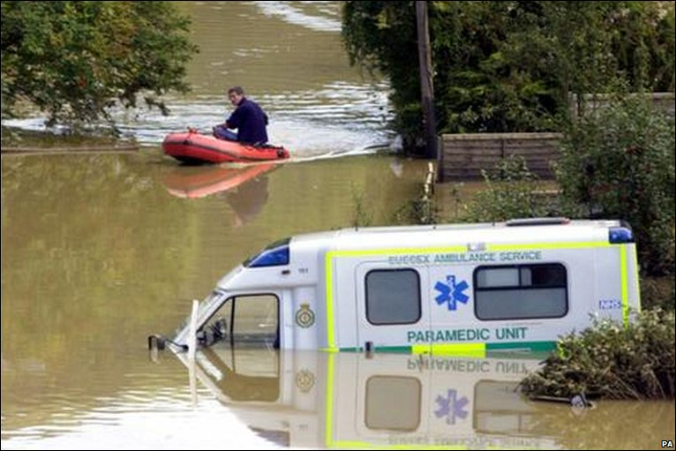
Development of master curricula for natural disasters risk management in Western Balkan countries
Thank you!
My email – m.dawney@mdx.ac.uk

